Slide 1
COMP 2230
Week 3 - Friday

Slide 2
Last time
Recurrence relations
Solving recurrence by iteration

Slide 3
Questions?

Slide 4
Assignment 2

Slide 5
Back to Solving Recurrence Relations by Iteration

Slide 6
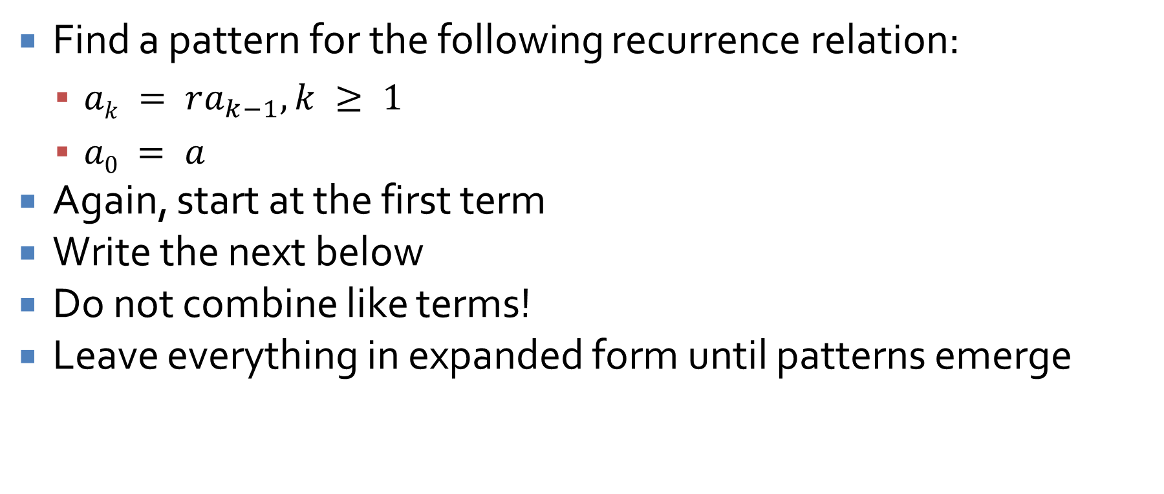
Geometric sequence
Find a pattern for the following recurrence relation:
  $ak = ra_{k−1}, k ≥ 1$
  $a0 = a$
Again, start at the first term
Write the next below
Do not combine like terms!
Leave everything in expanded form until patterns emerge

Slide 7
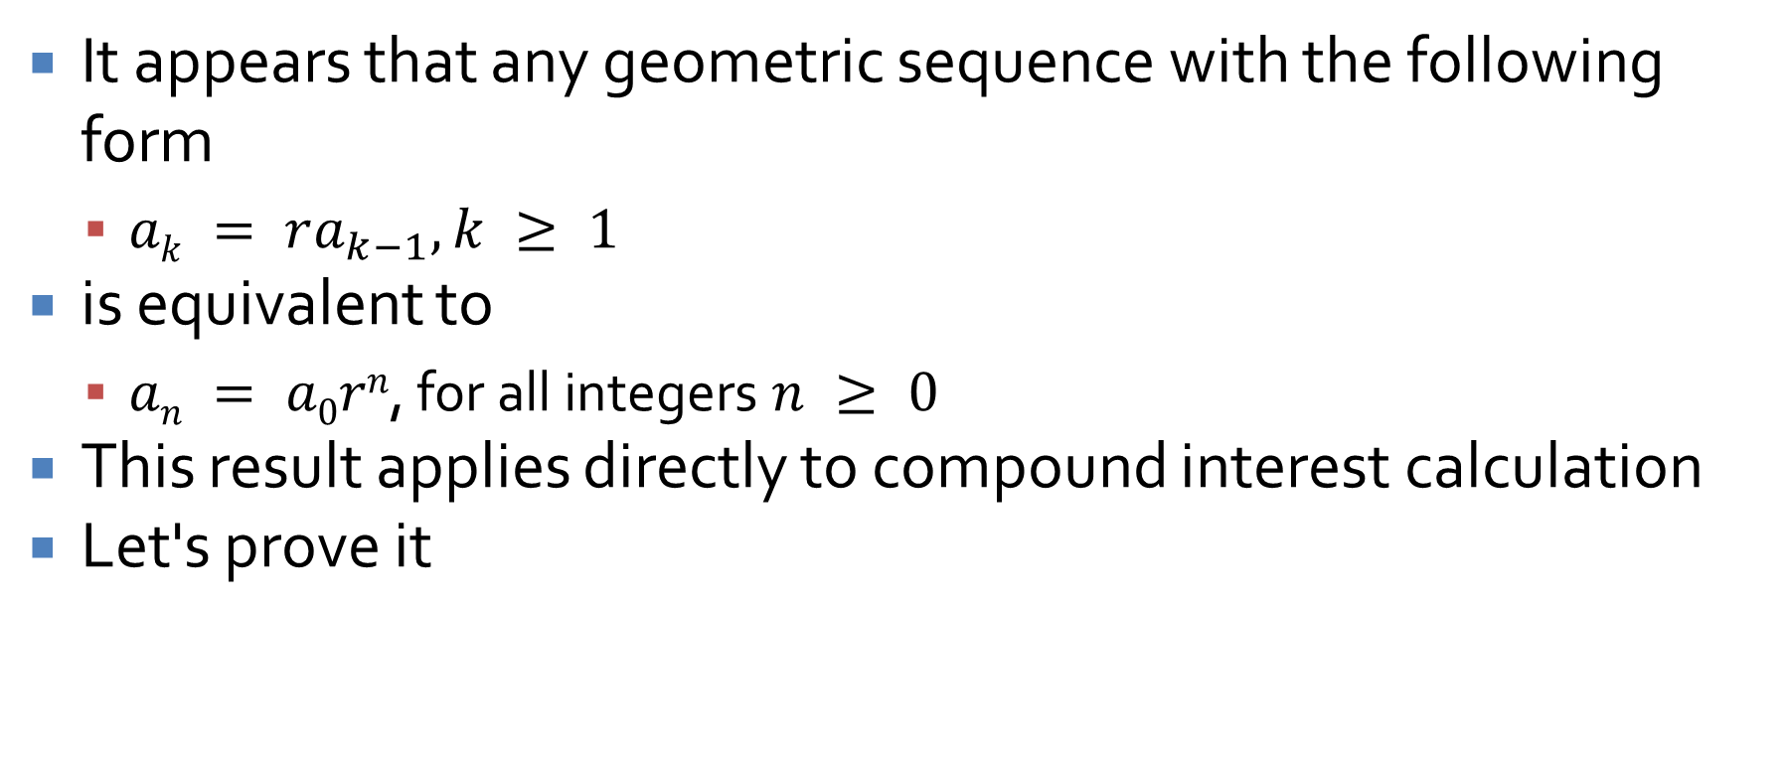
Geometric sequence
It appears that any geometric sequence with the following form
  $ak = ra_{k−1}, k ≥ 1$
is equivalent to
  $an = a0rn$, for all integers $n ≥ 0$
This result applies directly to compound interest calculation
Let's prove it

Slide 8
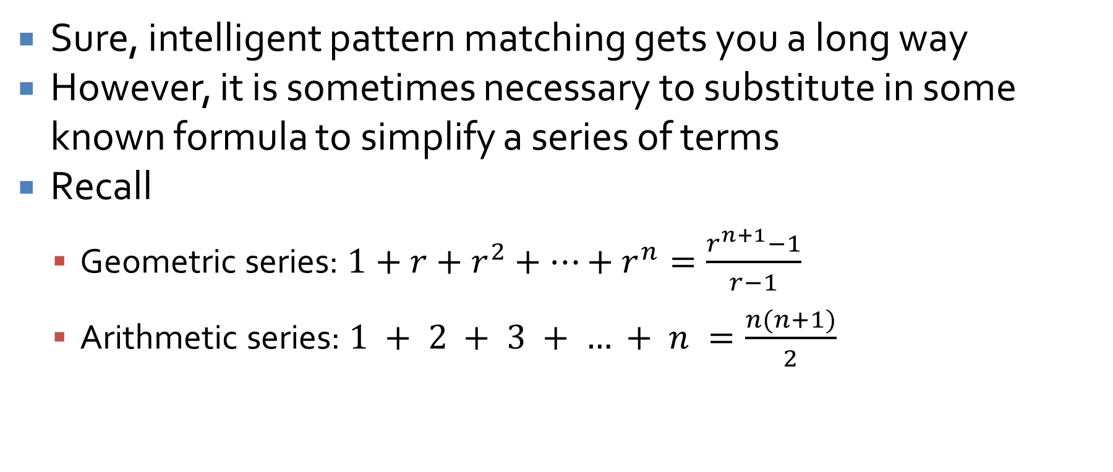
Employing outside formulas
Sure, intelligent pattern matching gets you a long way
However, it is sometimes necessary to substitute in some known formula to simplify a series of terms
Recall
  Geometric series: $1+r+r^{2}+…+r^{n}=\frac{r^{n+1}−1}{r−1}$
  Arithmetic series: $1 + 2 + 3 + … + n =\frac{n(n+1)}{2}$

Slide 9
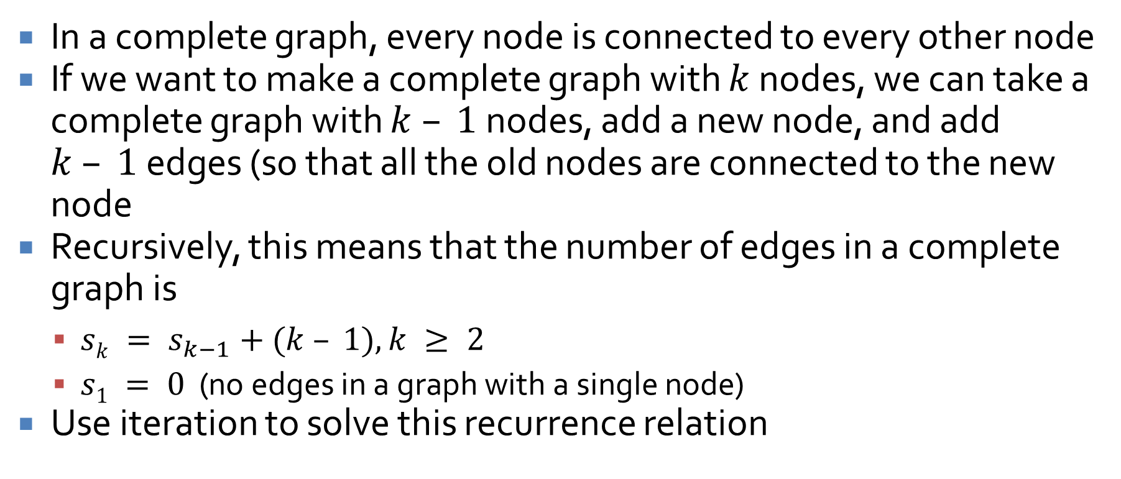
How many edges are in a complete graph?
In a complete graph, every node is connected to every other node
If we want to make a complete graph with $k$ nodes, we can take a complete graph with $k – 1$nodes, add a new node, and add $k – 1$edges (so that all the old nodes are connected to the new node
Recursively, this means that the number of edges in a complete graph is
  $sk = s_{k−1}+(k – 1), k ≥ 2$
  $s1 = 0$ (no edges in a graph with a single node)
Use iteration to solve this recurrence relation

Slide 10
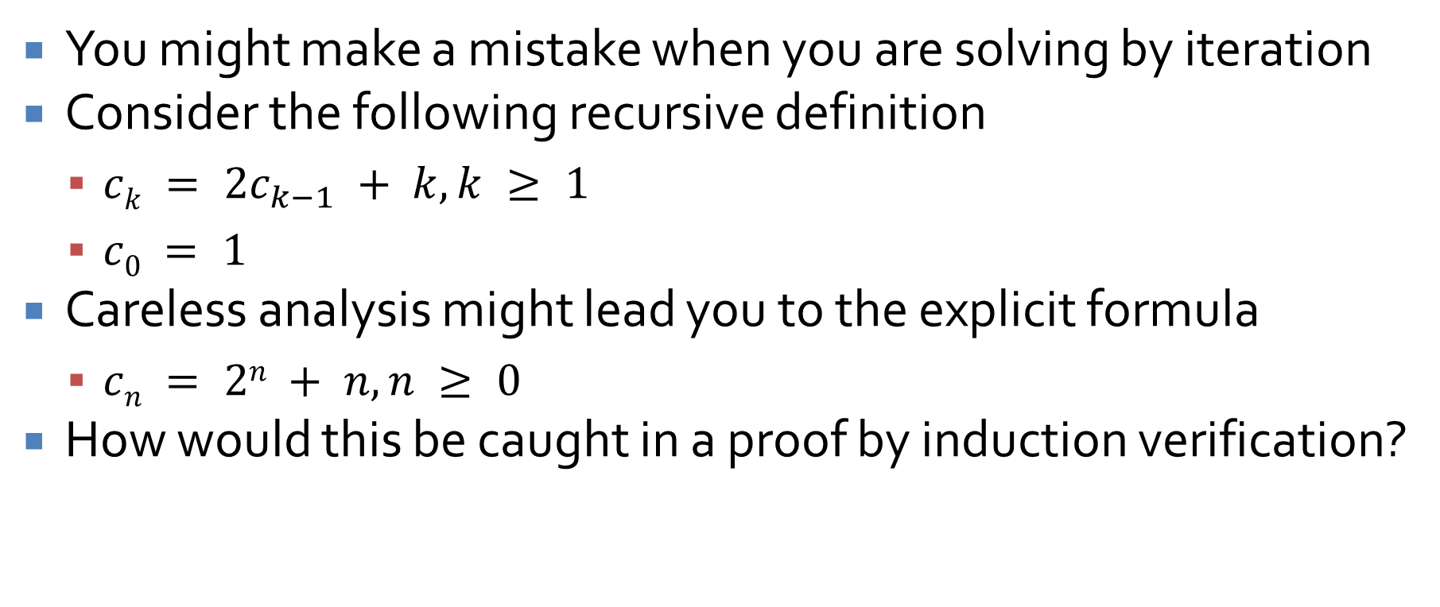
Mistakes were made!
You might make a mistake when you are solving by iteration
Consider the following recursive definition
  $ck = 2c_{k−1} + k, k ≥ 1$
  $c0 = 1$
Careless analysis might lead you to the explicit formula
  $cn = 2n + n, n ≥ 0$
How would this be caught in a proof by induction verification?

Slide 11
Solving Second-Order Linear Homogeneous Relations with Constant Coefficients

Slide 12
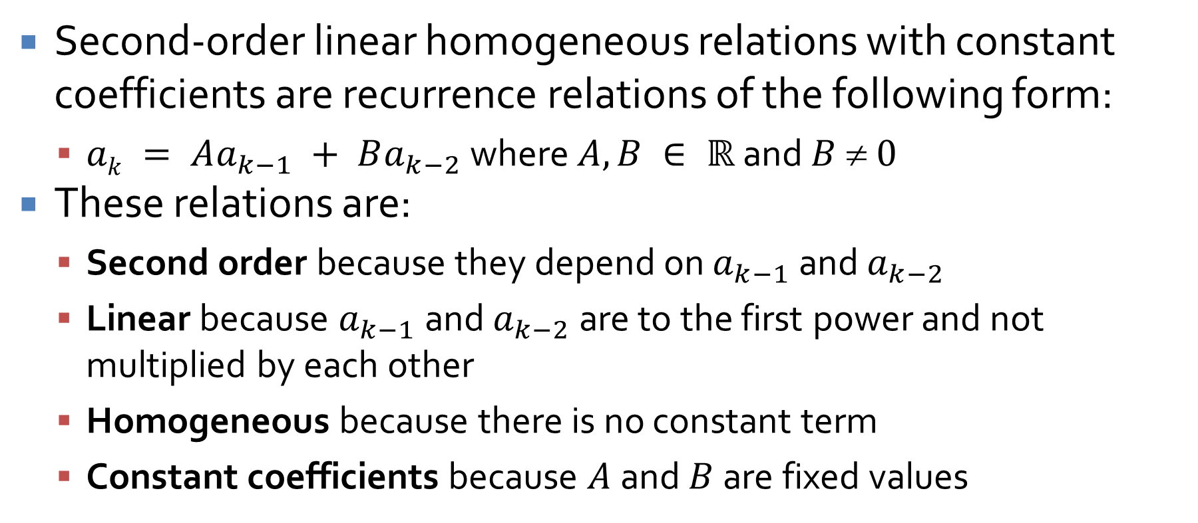
Second-order linear homogeneous relations with constant coefficients
Second-order linear homogeneous relations with constant coefficients are recurrence relations of the following form:
  $ak = Aa_{k−1} + Ba_{k−2}$ where $A, B ∈ ℝ$ and $B  0$
These relations are:
  Second order because they depend on $a_{k−1}$ and $a_{k−2}$
  Linear because $a_{k−1}$ and $a_{k−2}$ are to the first power and not multiplied by each other
  Homogeneous because there is no constant term
  Constant coefficients because $A$ and $B$ are fixed values

Slide 13
Why do we care?
I'm sure you're thinking that this is an awfully narrow class of recurrence relations to have special rules for
It's true: There are many (infinitely many) ways to formulate a recurrence relation
  Some have explicit formulas
  Some do not have closed explicit formulas
We care about this one partly for two reasons
  We can solve it
  It lets us get an explicit formula for Fibonacci!

Slide 14
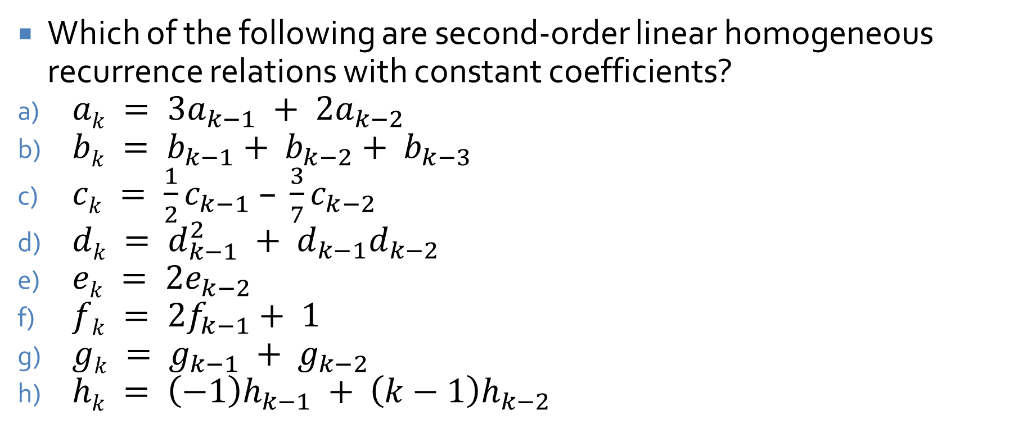
Pick 'em out
Which of the following are second-order linear homogeneous recurrence relations with constant coefficients?
$ak = 3a_{k−1} + 2a_{k−2}$
$bk = b_{k−1}+ b_{k−2}+ b_{k−3}$
$ck = \frac{1}{2}c_{k−1} – \frac{3}{7}c_{k−2}$
$dk = d_{k−1}^{2} + d_{k−1}d_{k−2}$
$ek = 2e_{k−2}$
$fk = 2f_{k−1}+ 1$
$gk = g_{k−1} + g_{k−2}$
$hk = \left(−1\right)h_{k−1} + \left(k−1\right)h_{k−2}$

Slide 15
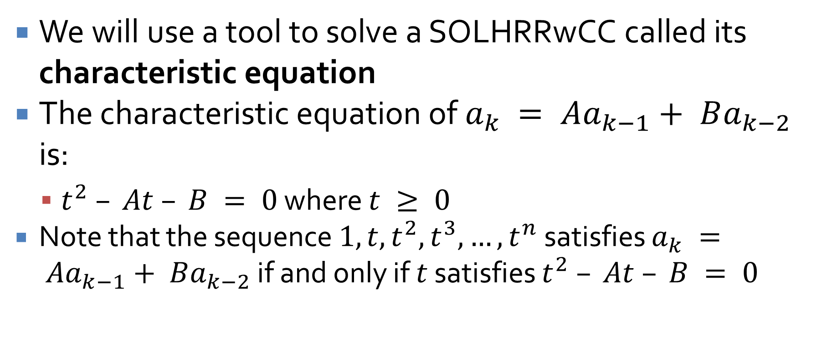
Characteristic equation
We will use a tool to solve a SOLHRRwCC called its characteristic equation
The characteristic equation of $a_{k} = Aa_{k−1}+ Ba_{k−2}$ is:
  $t^{2} – At – B = 0$ where $t ≥ 0$
  Note that the sequence $1, t, t^{2}, t^{3}, …, t^{n}$ satisfies $a_{k} = Aa_{k−1}+ Ba_{k−2}$ if and only if $t$ satisfies $t^{2} – At – B = 0$

Slide 16
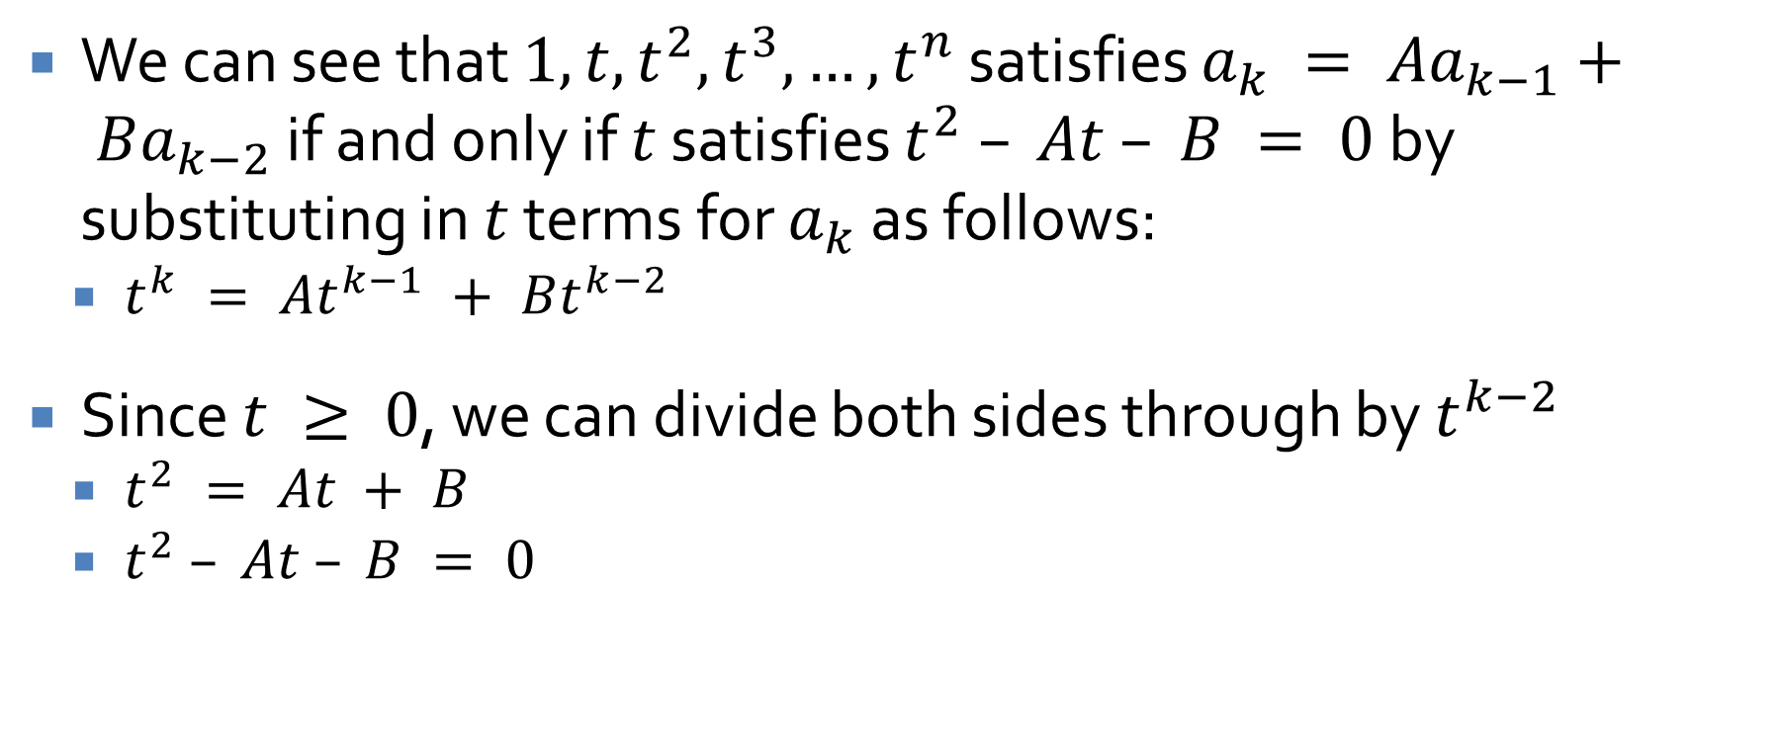
Demonstrating the characteristic equation
  We can see that $1, t, t^{2}, t^{3}, …, t^{n}$ satisfies $a_{k} = Aa_{k−1}+ Ba_{k−2}$ if and only if $t$ satisfies $t^{2} – At – B = 0$by substituting in $t$ terms for $a_{k}$ as follows:
    $t^{k} = At^{k−1} + Bt^{k−2}$
  Since $t ≥ 0$, we can divide both sides through by $t^{k−2}$
    $t^{2} = At + B$
    $t^{2} – At – B = 0$

Slide 17
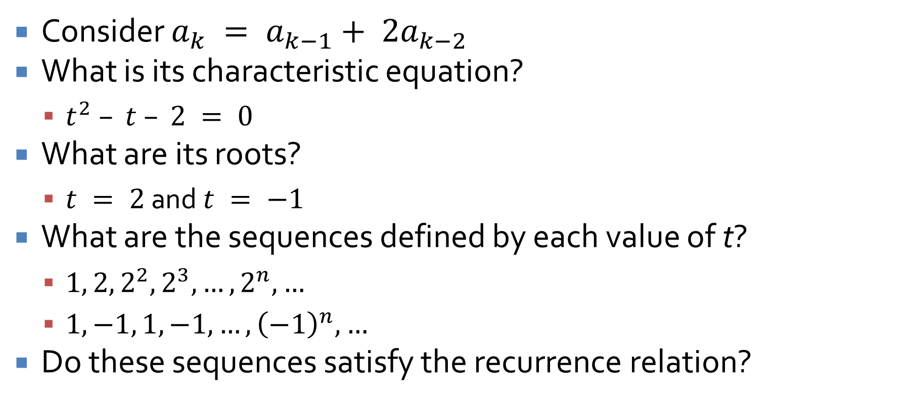
Using the characteristic equation
Consider $a_{k} = a_{k−1}+ 2a_{k−2}$
What is its characteristic equation?
  $t^{2} – t – 2 = 0$
What are its roots?
  $t = 2$ and $t = −1$
What are the sequences defined by each value of t?
  $1, 2, 2^{2}, 2^{3}, …, 2^{n}, …$
  $1, −1, 1, −1, …, {\left(−1\right)}^{n}, …$
Do these sequences satisfy the recurrence relation?

Slide 18
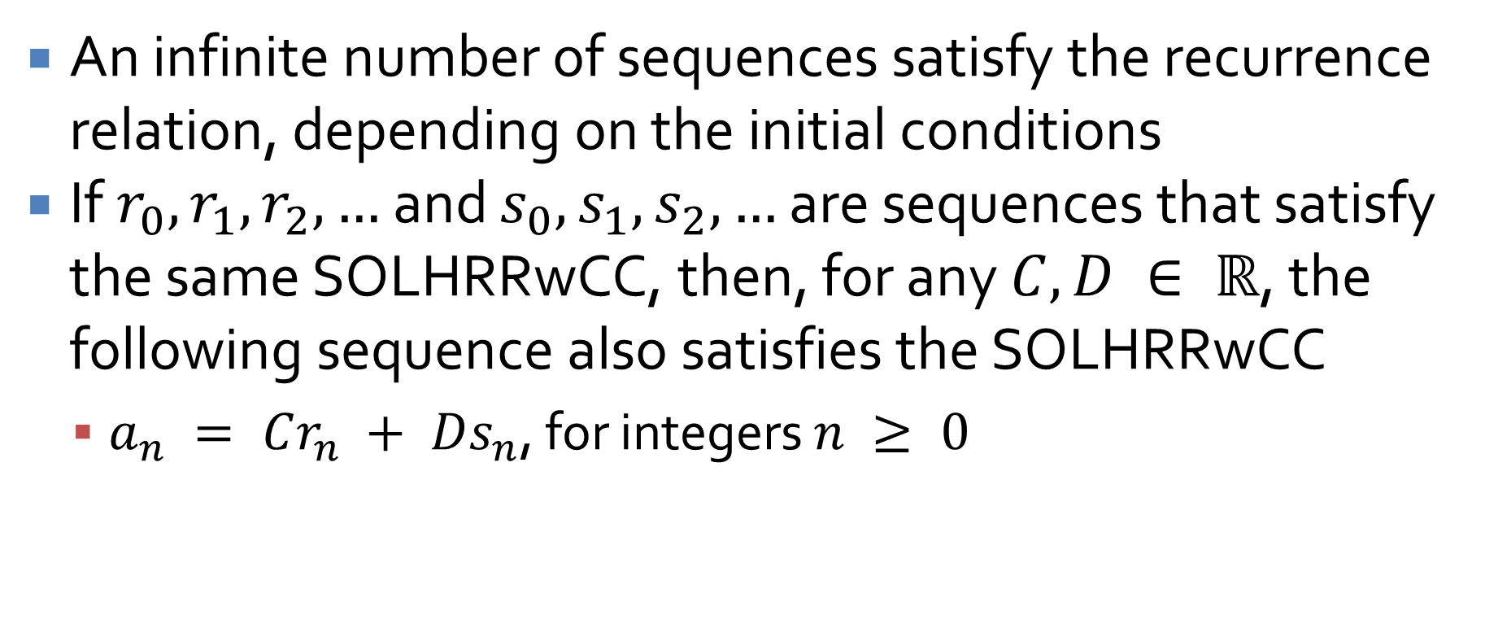
Finding other sequences
An infinite number of sequences satisfy the recurrence relation, depending on the initial conditions
If $r_{0}, r_{1}, r_{2}, …$ and $s_{0}, s_{1}, s_{2}, …$ are sequences that satisfy the same SOLHRRwCC, then, for any $C, D ∈ ℝ$, the following sequence also satisfies the SOLHRRwCC
  $a_{n} = Cr_{n} + Ds_{n}$, for integers $n ≥ 0$

Slide 19
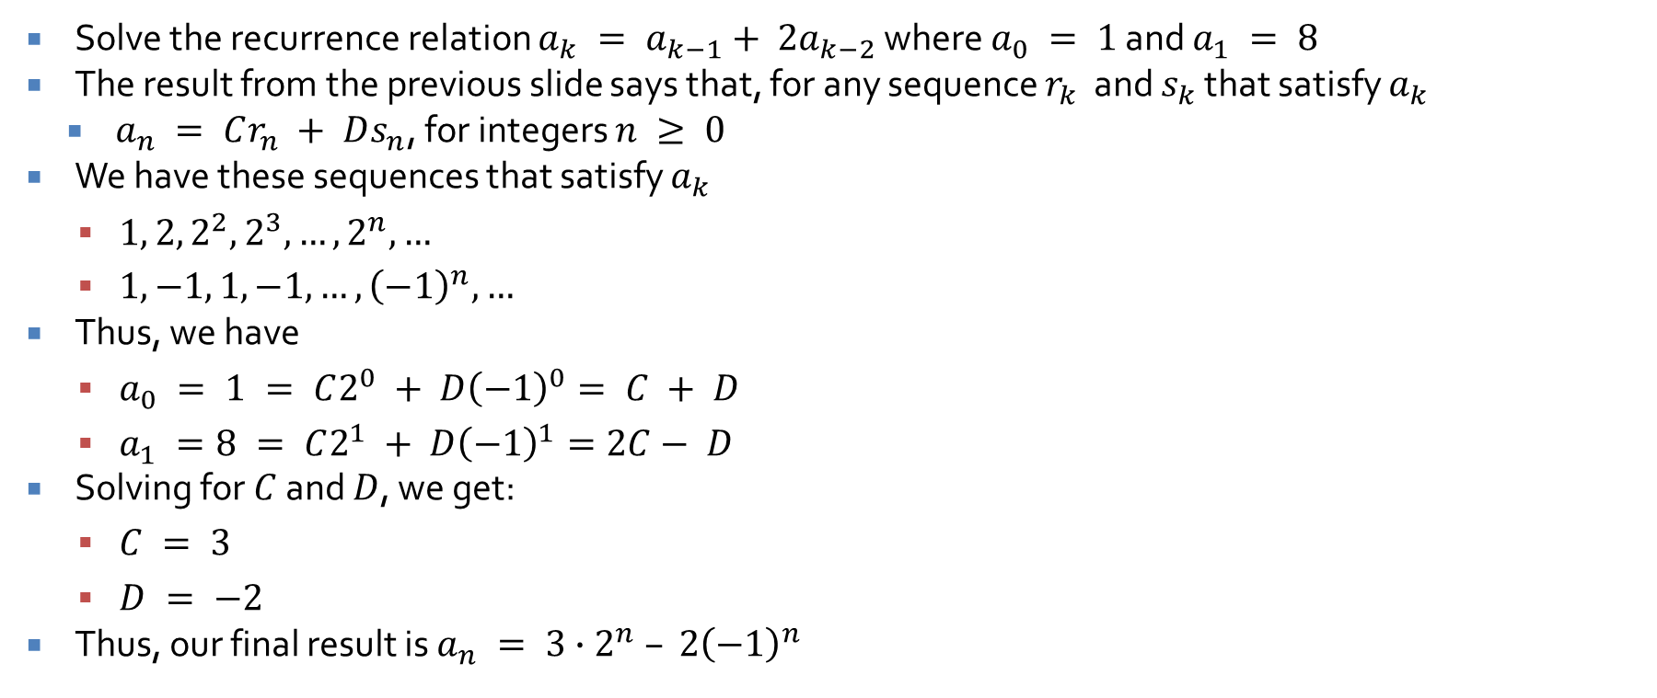
Finding a sequence with specific initial conditions
Solve the recurrence relation $a_{k} = a_{k−1}+ 2a_{k−2}$ where $a_{0} = 1$ and $a_{1} = 8$
The result from the previous slide says that, for any sequence $r_{k}$ and $s_{k}$ that satisfy $a_{k}$
    $a_{n} = Cr_{n} + Ds_{n}$, for integers $n ≥ 0$
  We have these sequences that satisfy $a_{k}$
  $1, 2, 2^{2}, 2^{3}, …, 2^{n}, …$
  $1, −1, 1, −1, …, {\left(−1\right)}^{n}, …$
Thus, we have
  $a_{0} = 1 = C2^{0} + D{\left(−1\right)}^{0}= C + D$
  $a_{1} =8 = C2^{1} + D{\left(−1\right)}^{1}=2C− D$
Solving for $C$ and $D$, we get:
  $C = 3$
  $D = −2$
Thus, our final result is $a_{n} = 3∙2^{n} – 2{\left(−1\right)}^{n}$

Slide 20
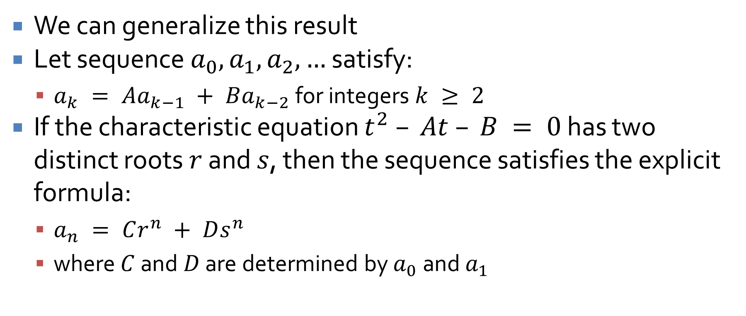
Distinct Roots Theorem
We can generalize this result
Let sequence $a_{0}, a_{1}, a_{2}, …$ satisfy:
  $a_{k} = Aa_{k−1} + Ba_{k−2}$ for integers $k ≥ 2$
If the characteristic equation $t^{2} – At – B = 0$ has two distinct roots $r$ and $s$, then the sequence satisfies the explicit formula:
  $a_{n} = Cr^{n} + Ds^{n}$
  where $C$ and $D$ are determined by $a_{0}$ and $a_{1}$

Slide 21
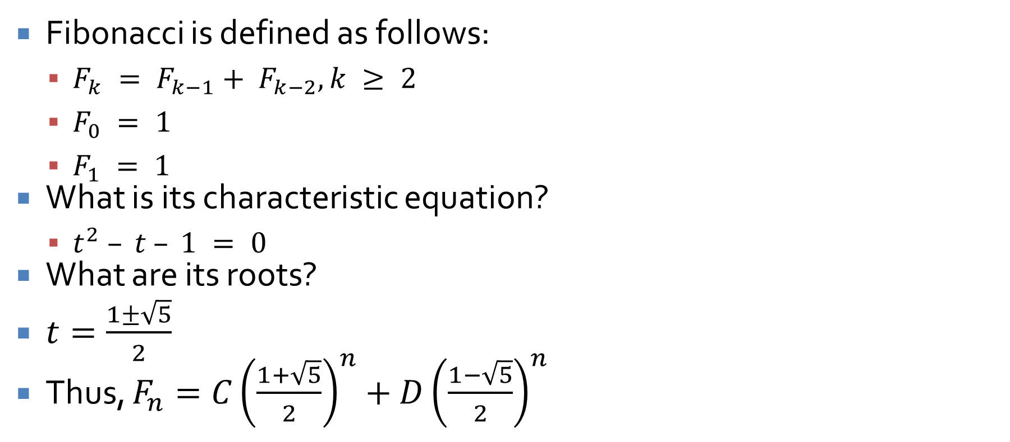
Now we can solve Fibonacci!
Fibonacci is defined as follows:
  $F_{k} = F_{k−1}+ F_{k−2}, k ≥ 2$
  $F_{0} = 1$
  $F_{1} = 1$
What is its characteristic equation?
  $t^{2} – t – 1 = 0$
What are its roots?
$t=\frac{1±\sqrt{5}}{2}$
Thus, $F_{n}=C{\left(\frac{1+\sqrt{5}}{2}\right)}^{n}+D{\left(\frac{1−\sqrt{5}}{2}\right)}^{n}$

Slide 22
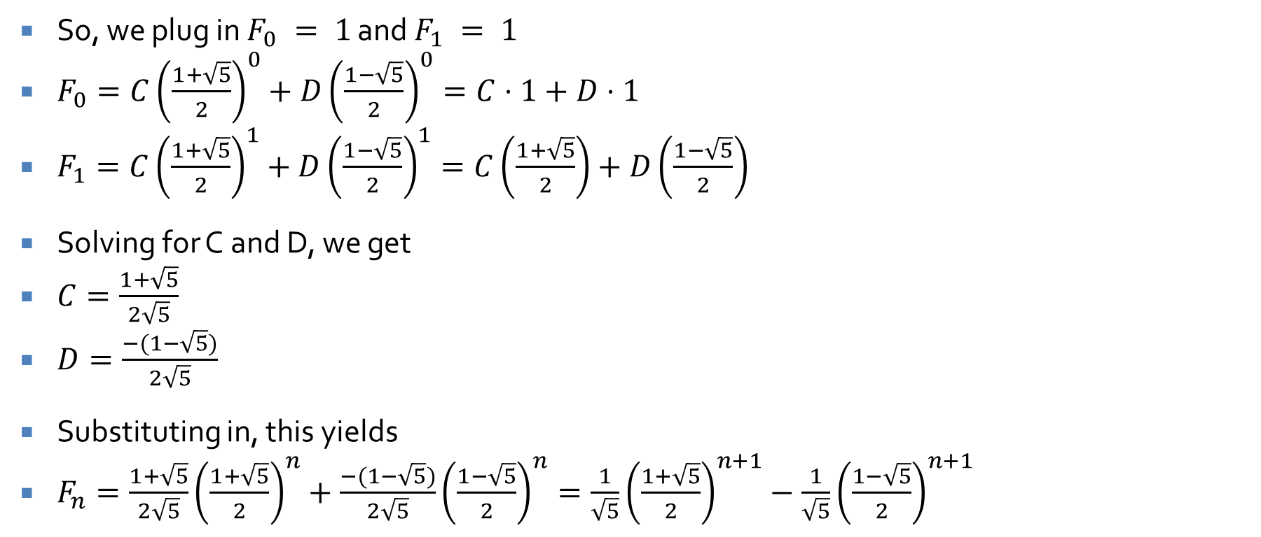

We just need $C$ and $D$
So, we plug in $F_{0} = 1$ and $F_{1} = 1$
$F_{0}=C{\left(\frac{1+\sqrt{5}}{2}\right)}^{0}+D{\left(\frac{1−\sqrt{5}}{2}\right)}^{0}=C⋅1+D⋅1$
$F_{1}=C{\left(\frac{1+\sqrt{5}}{2}\right)}^{1}+D{\left(\frac{1−\sqrt{5}}{2}\right)}^{1}=C\left(\frac{1+\sqrt{5}}{2}\right)+D\left(\frac{1−\sqrt{5}}{2}\right)$
Solving for C and D, we get
$C=\frac{1+\sqrt{5}}{2\sqrt{5}}$
$D=\frac{−(1−\sqrt{5})}{2\sqrt{5}}$
Substituting in, this yields
$F_{n}=\frac{1+\sqrt{5}}{2\sqrt{5}}{\left(\frac{1+\sqrt{5}}{2}\right)}^{n}+\frac{−(1−\sqrt{5})}{2\sqrt{5}}{\left(\frac{1−\sqrt{5}}{2}\right)}^{n}=\frac{1}{\sqrt{5}}{\left(\frac{1+\sqrt{5}}{2}\right)}^{n+1}−\frac{1}{\sqrt{5}}{\left(\frac{1−\sqrt{5}}{2}\right)}^{n+1}$

Slide 23
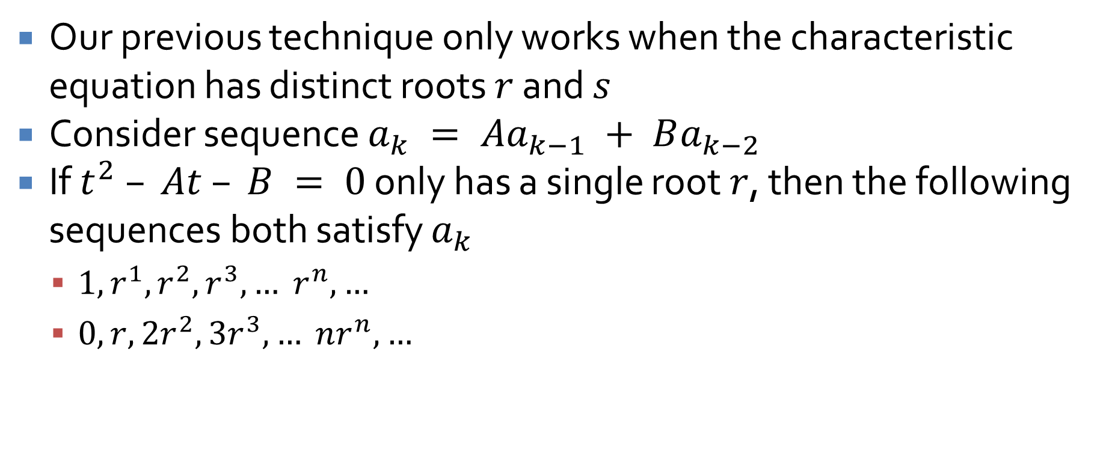
Single-Root Case
Our previous technique only works when the characteristic equation has distinct roots $r$ and $s$
Consider sequence $a_{k} = Aa_{k−1} + Ba_{k−2}$
If $t^{2} – At – B = 0$ only has a single root $r$, then the following sequences both satisfy $a_{k}$
  $1, r^{1}, r^{2}, r^{3}, … r^{n}, …$
  $0, r, 2r^{2}, 3r^{3}, … nr^{n}, …$

Slide 24
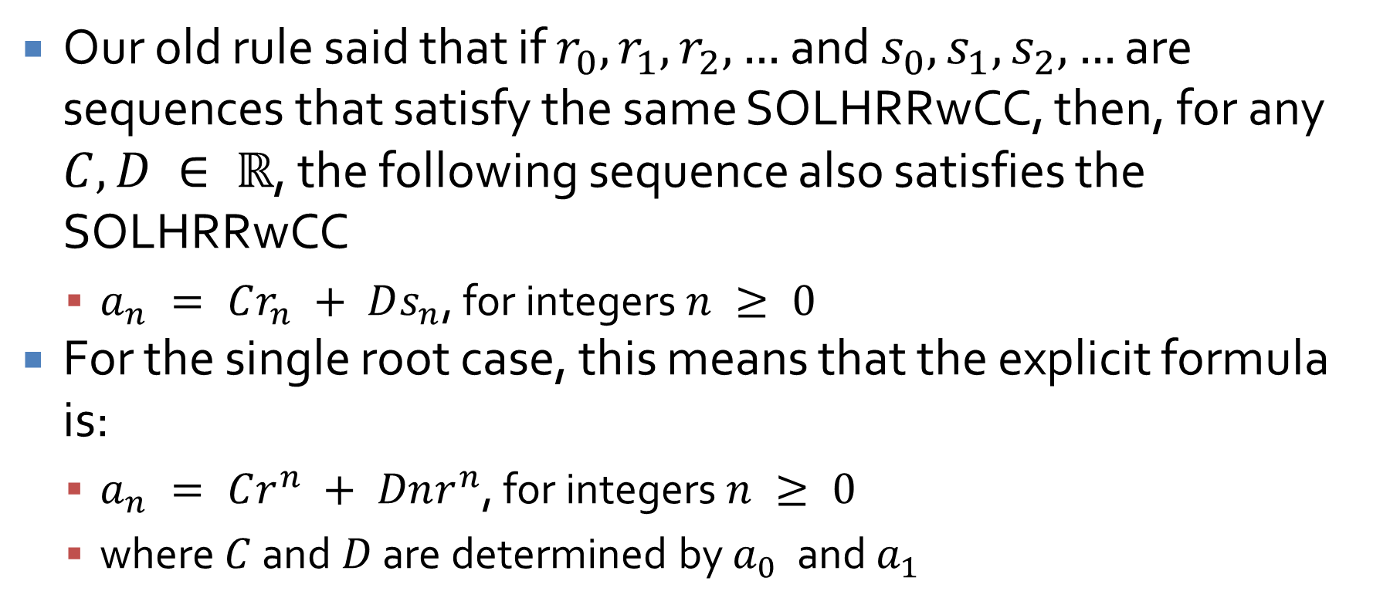
Single root equation
Our old rule said that if $r_{0}, r_{1}, r_{2}, …$ and $s_{0}, s_{1}, s_{2}, …$ are sequences that satisfy the same SOLHRRwCC, then, for any $C, D ∈ ℝ$, the following sequence also satisfies the SOLHRRwCC
  $a_{n} = Cr_{n} + Ds_{n}$, for integers $n ≥ 0$
For the single root case, this means that the explicit formula is:
  $a_{n} = Cr^{n} + Dnr^{n}$, for integers $n ≥ 0$
  where $C$ and $D$ are determined by $a_{0}$ and $a_{1}$

Slide 25
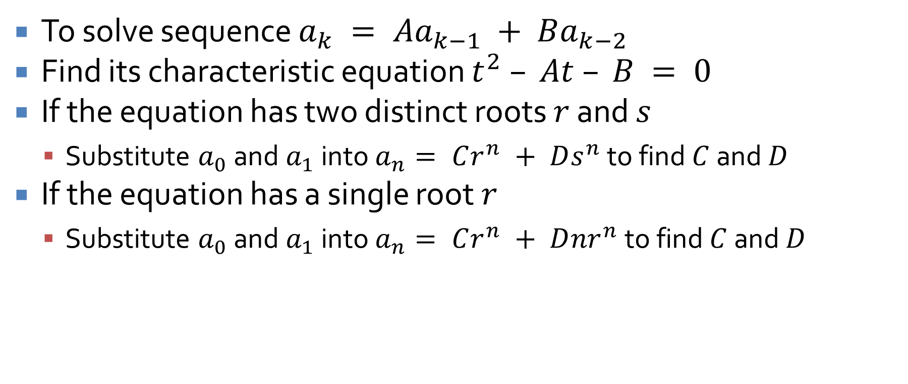
SOLHRRwCC TL;DR
To solve sequence $a_{k} = Aa_{k−1} + Ba_{k−2}$
Find its characteristic equation $t^{2} – At – B = 0$
If the equation has two distinct roots $r$ and $s$
  Substitute $a_{0}$ and $a_{1}$ into $a_{n}= Cr^{n} + Ds^{n}$ to find $C$ and $D$
If the equation has a single root $r$
  Substitute $a_{0}$ and $a_{1}$ into $a_{n}= Cr^{n} + D{nr}^{n}$ to find $C$ and $D$

Slide 26
Upcoming

Slide 27
Next time…
General recursive definitions

Slide 28
Reminders
Work on Assignment 2
  Due next Friday
No class on Monday!
Read 5.9 for Wednesday

